Slide 1
Review
Yao ZHao

Slide 2

Stable Matching Time complexity Graph Traversal Greedy algorithms Divide and conquer Dynamic Programming Network flow
Outline

Slide 3
This PPT only reviews the key knowledge points but does not represent the scope of the exam

Slide 4
Stable
Matching

Slide 5
Time complexity
Greedy algorithm
n
n²
n³
n^{k}
logn
nlogn
n！
2^{n}
Interval scheduling, Prim, Kruskal,…
Classic Algorithm Time Complexity
Common Algorithm and Time complexity
Divide and conquer
Time complexity
Merge Sort, FFT,…
DP
Graph traversal
Network flow
Weighted Interval scheduling, Knapsack problem,
…
BFS,DFS,…
Ford Fulkerson …

Slide 6
Graph Traversal
Adjacency Matrix
Adjacency List
s-t connectivity problem
s-t shortest path problem
BFS
DFS
Graph Representation
Graph Traversal
Topological Ordering

Slide 7
Greedy Algorithms
Induction
Exchange
Contradiction
Prim
Kruskal
Dijstra
How to proof
Huffman
well-known applications
Greedy Algorithms
Construct a graph
Application
Interval Problem
Tree or graph
Greedy solves a part of a problem
Notes:
Pf. (by contradiction)
Assume greedy is not optimal, and let's see what happens.
Let i1, i2, ... ik denote set of jobs selected by greedy.
Let j1, j2, ... jm denote set of jobs in the optimal solution withi1 = j1, i2 = j2, ..., ir = jr for the largest possible value of r.

Slide 8
Divide and conquer
How to divide to sub-problems？
How to merge
Closest pair of points
Multiply
Counting inversions
Merge Sort
Core
well-known applications
Convolution and FFT
Divide and conquer
convert
Applications

Slide 9
Dynamic Programming
Recursive Formula
01
Segmented Least Squares
RNA
Sequence Alignment
Weighted Interval scheduling
well-known applications
Completely
Core
Bellman-Ford
Multiple
Dynamic Programming
knapsacks
two-dimensional
difference
convert
Packet
Applications
Mix
Greedy Algorithm
Divide and Conquer

Slide 10
Maximum
flow

Slide 11
Dynamic Programming vs Divide-and-Conquer
DP：subproblems overlap
Divide-and-Conquer ：Subproblems disjoint
5
1
3
4
1
2
3
2
2
4
5
6
7
1
1
1
1

Slide 12
Dynamic Programming vs Greedy Algorithm
DP：go through a sequence of steps,
with a set of choices at each step
Greedy Algorithm ： always makes the choice that looks best at the moment
5
5
3
4
3
4
1
1
2
2
2
1
1
1
1
1
1

Slide 13
A Typical Dynamic Programming Problem
F(5)
5
3
4
1
F(3)
F(4)
2
2
1
1
1
1
F(2)
F(1)
F(3)
F(2)
Fibonacci:
F(1)=1，
F(2)=1,
F(n)=F(n-1)+F(n-2)（n>=3，n∈N*）
F(2)
F(1)

Slide 14
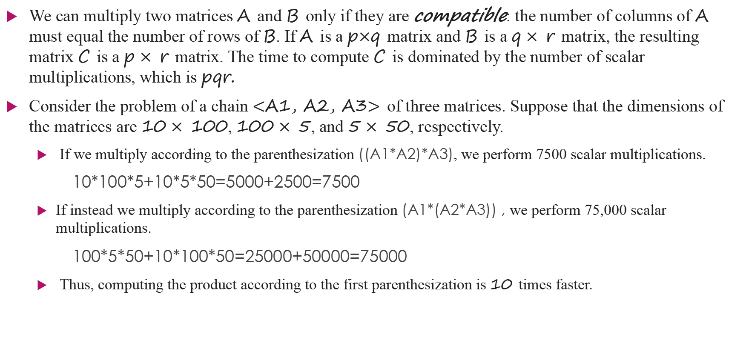
Matrix-chain multiplication
We can multiply two matrices A and B only if they are compatible: the number of columns of A must equal the number of rows of B. If A is a p$×$q matrix and B is a q $×$r matrix, the resulting matrix C is a p $×$r matrix. The time to compute C is dominated by the number of scalar multiplications, which is pqr.
Consider the problem of a chain $<$A1, A2, A3$>$ of three matrices. Suppose that the dimensions of the matrices are 10 $×$100, 100 $×$5, and 5 $×$50, respectively.
If we multiply according to the parenthesization ((A1*A2)*A3), we perform 7500 scalar multiplications.
10*100*5+10*5*50=5000+2500=7500
If instead we multiply according to the parenthesization (A1*(A2*A3)) , we perform 75,000 scalar multiplications.
100*5*50+10*100*50=25000+50000=75000
Thus, computing the product according to the first parenthesization is 10 times faster.

Slide 15
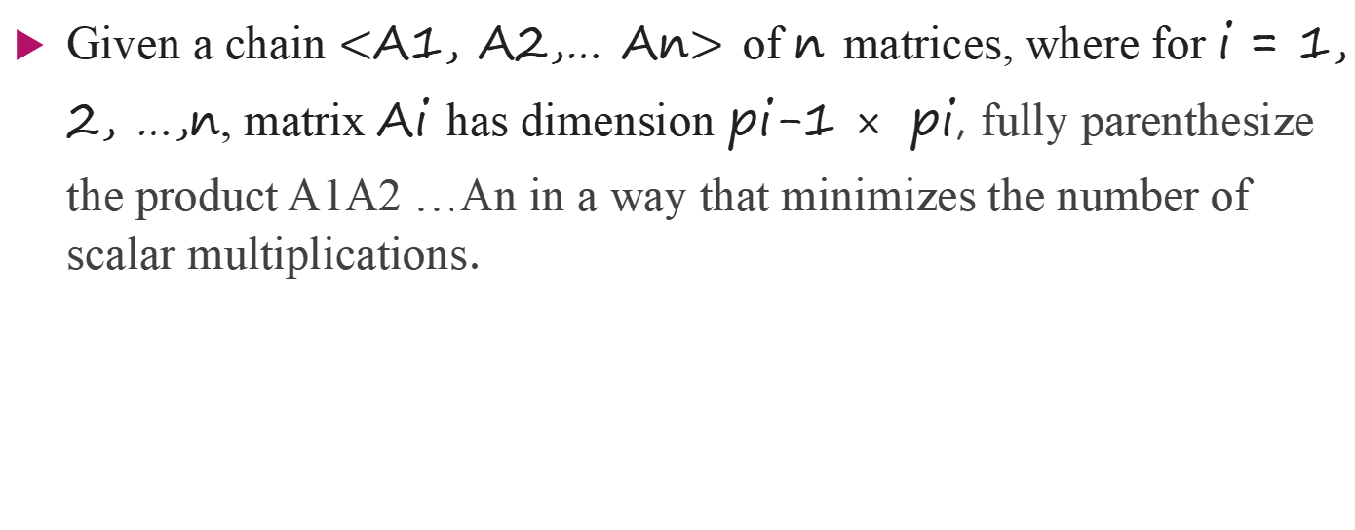
Matrix-chain multiplication
Given a chain $<$A1, A2,… An$>$ of n matrices, where for i = 1, 2, …,n, matrix Ai has dimension pi-1 $×$pi, fully parenthesize the product A1A2 …An in a way that minimizes the number of scalar multiplications.

Slide 16

Matrix-chain multiplication

